Slide 1



Using PDR Modeling Tools to Simulate Spectroscopic Observations from GUSTO
Aleah Short
Mentors: Dr. Christopher Walker and Dr. Craig Kulesa
Arizona Space Grant Symposium
April 19, 2025

Slide 2
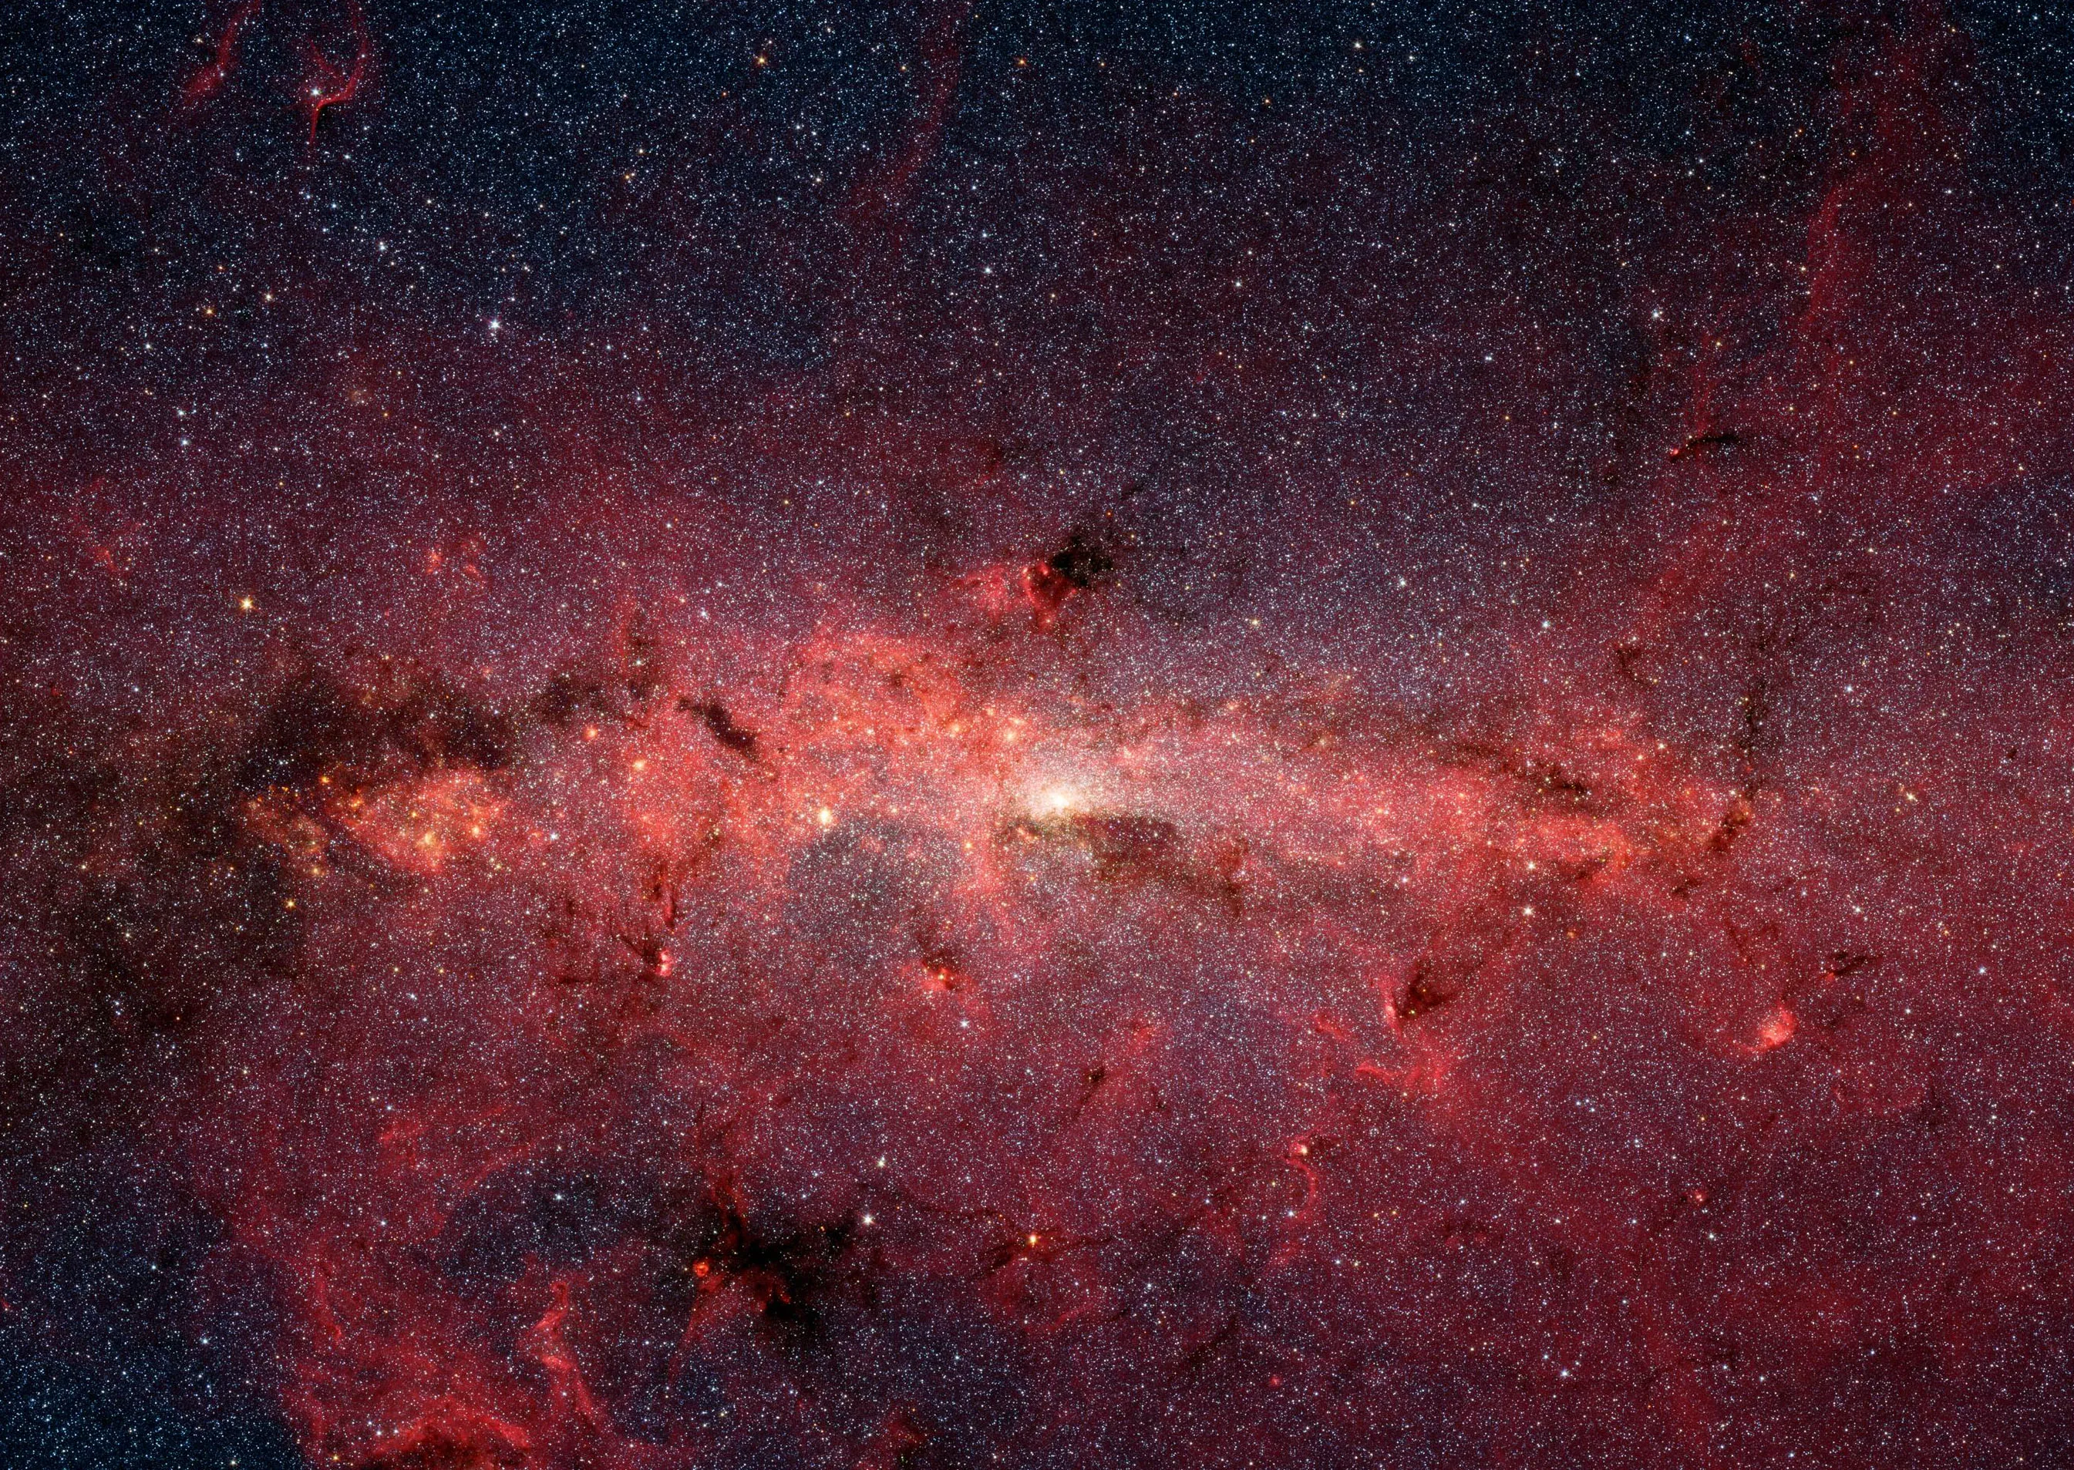
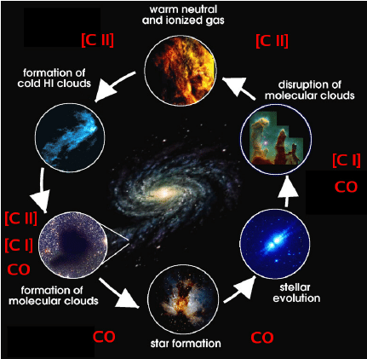
Context/The Interstellar Medium
2
The evolution of galaxies is governed by the interactions between clouds of gas/dust and stars
These interactions cause cycles in the interstellar medium (ISM)
Forms of carbon are involved in all of these processes, making it a vital molecule to study
Source: https://science.nasa.gov/image-detail/ssc2006-02a-0/
Source: https://www.researchgate.net/figure/Sketch-of-the-various-stages-in-the-life-cycle-of-interstellar-clouds_fig1_258788364

Slide 3
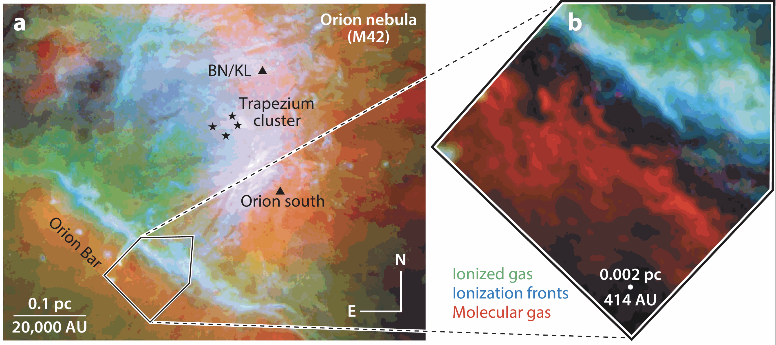
Photodissociation Regions (PDRs)
3
Clouds where the physics is driven by interactions with high-energy UV photons
As depth into the cloud increases, photons are absorbed, causing distinct layers to appear
Important structures to consider when studying how hot, young stars interact with the ISM
Source: https://www.annualreviews.org/content/journals/10.1146/annurev-astro-052920-010254
UV Photons
H+
H
H₂
O- and B-Type Stars
C+
C
CO

Slide 4
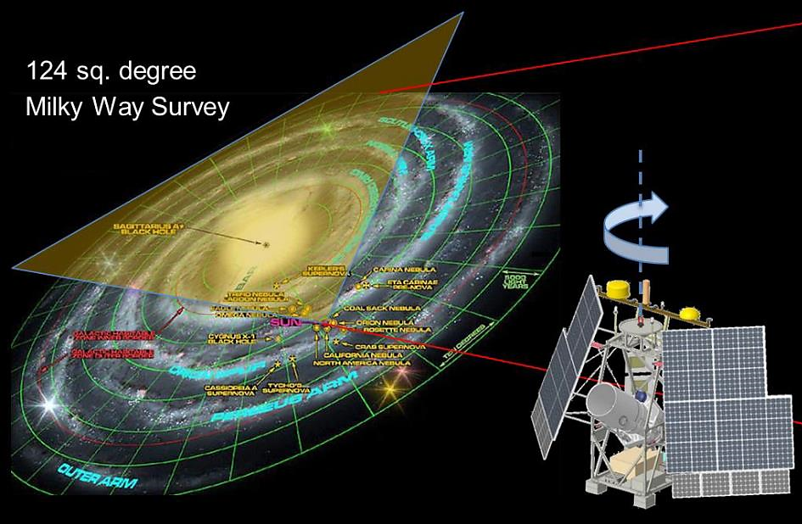
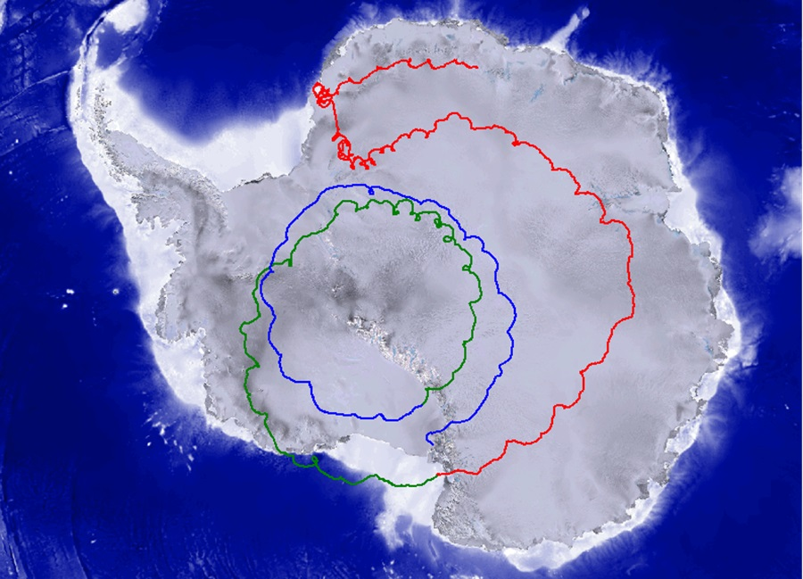
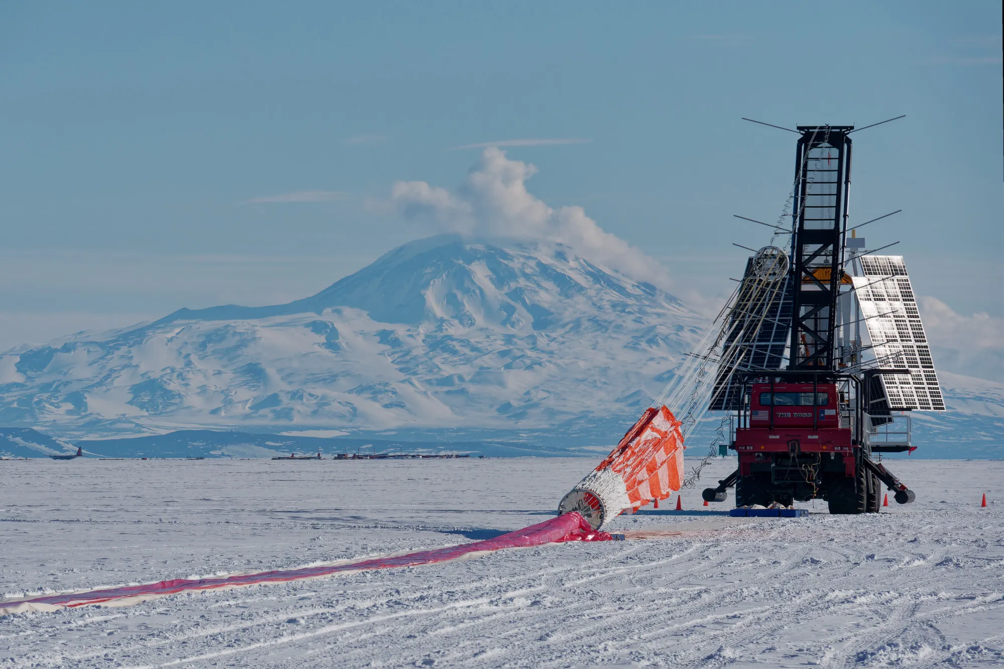
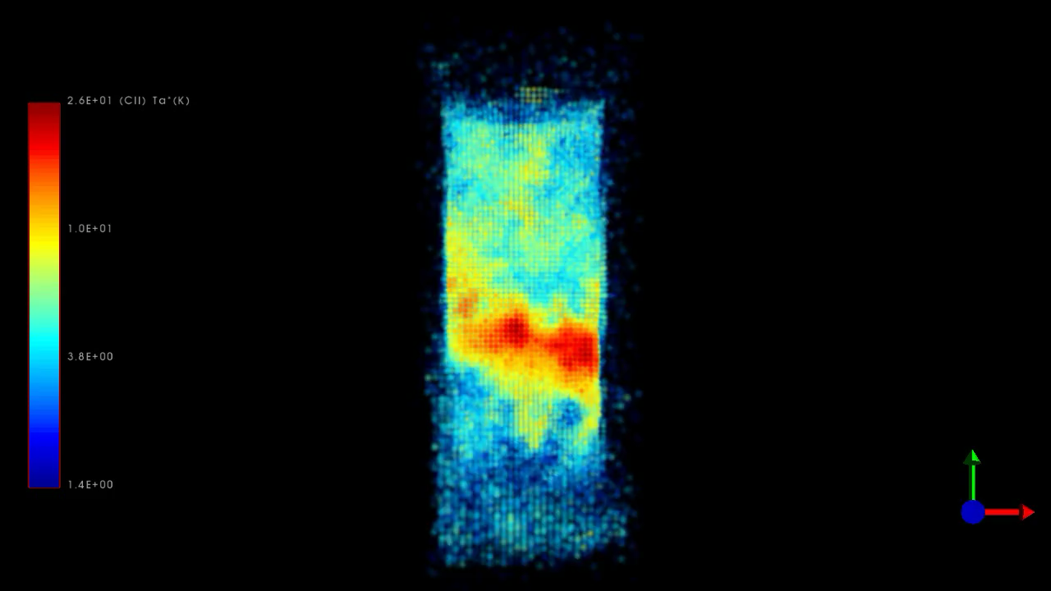
GUSTO
4
Balloon observatory that completed 57-day flight over Antarctica in early 2024
Mapped 62 square degrees of the Milky Way galaxy and parts of the Large Magellanic Cloud
Measured spectra of [CII] and [NII] through over a million lines of sight
Source: https://weatherboy.com/nasa-goes-for-the-gusto-with-record-breaking-scientific-balloon-flight/
Source: Chris Walker
Source: https://www.nasa.gov/image-article/gusto-balloon-mission-maintains-course-circling-https://science.nasa.gov/wp-content/uploads/2024/04/walker-gusto-march24-novideo.pdfantarctic-skies/
Source: Craig Kulesa

Slide 5
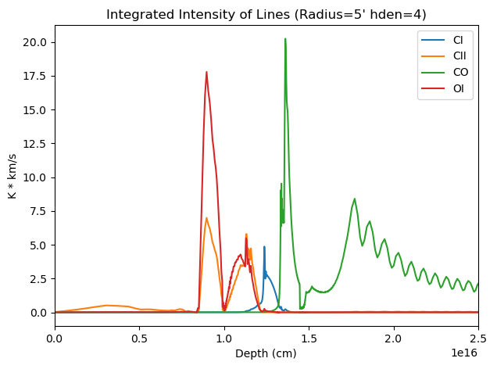
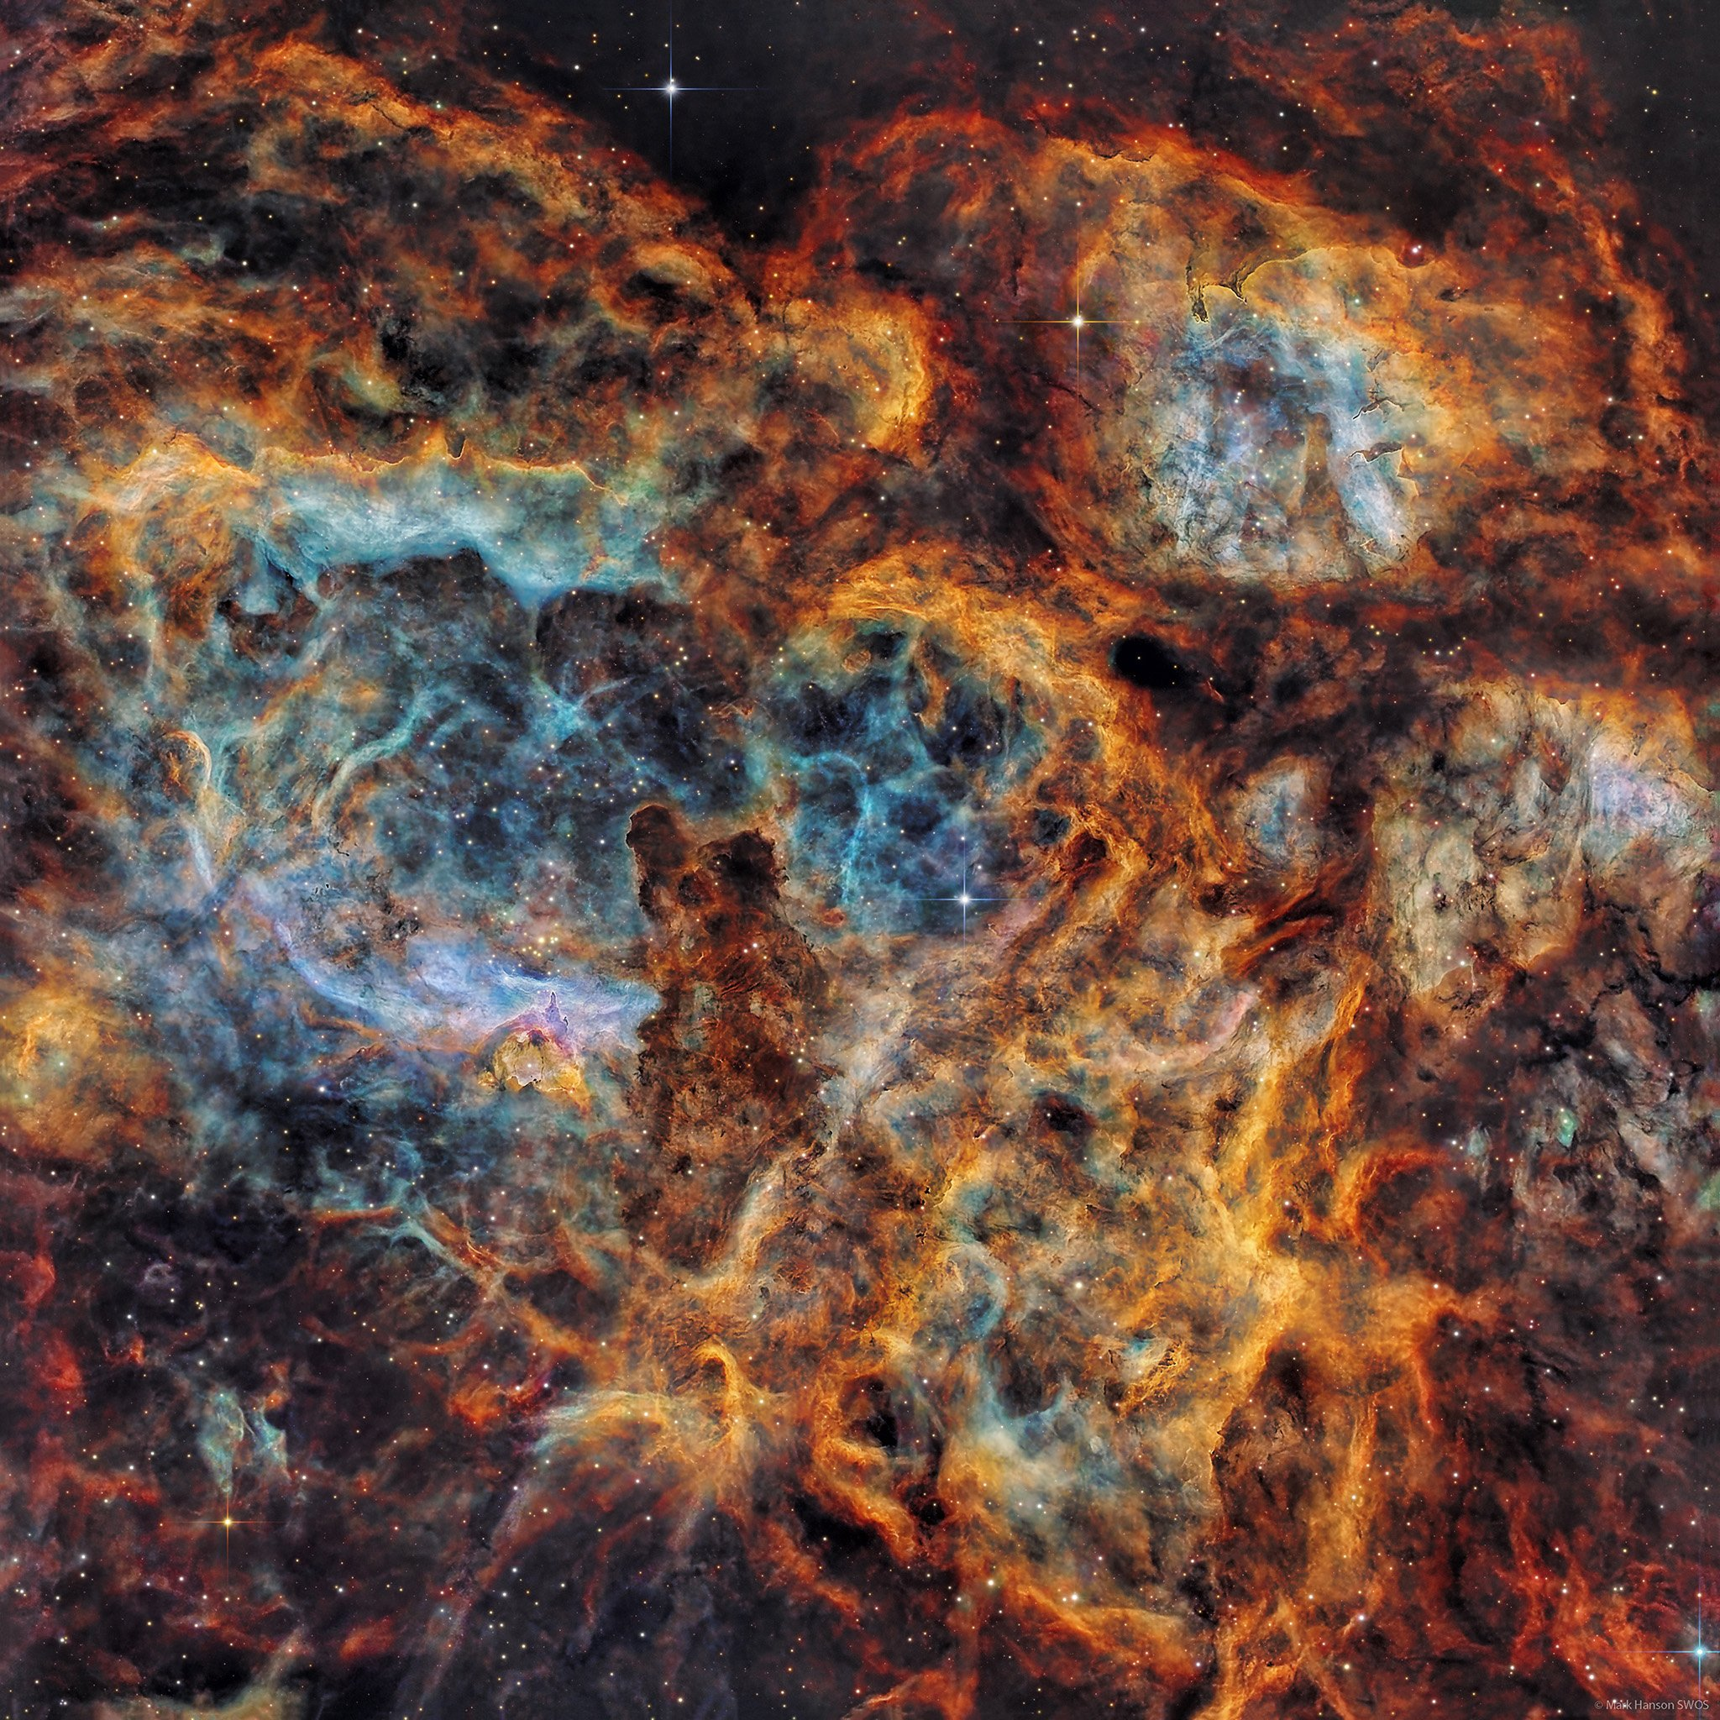
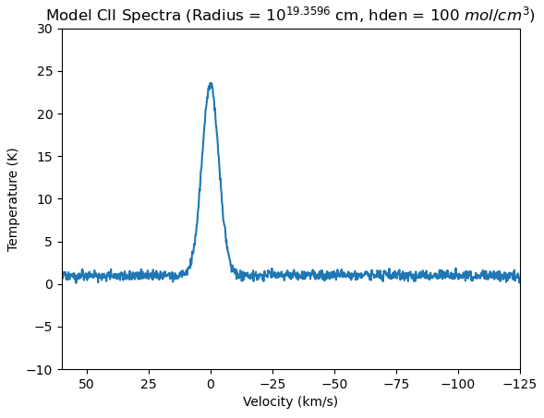
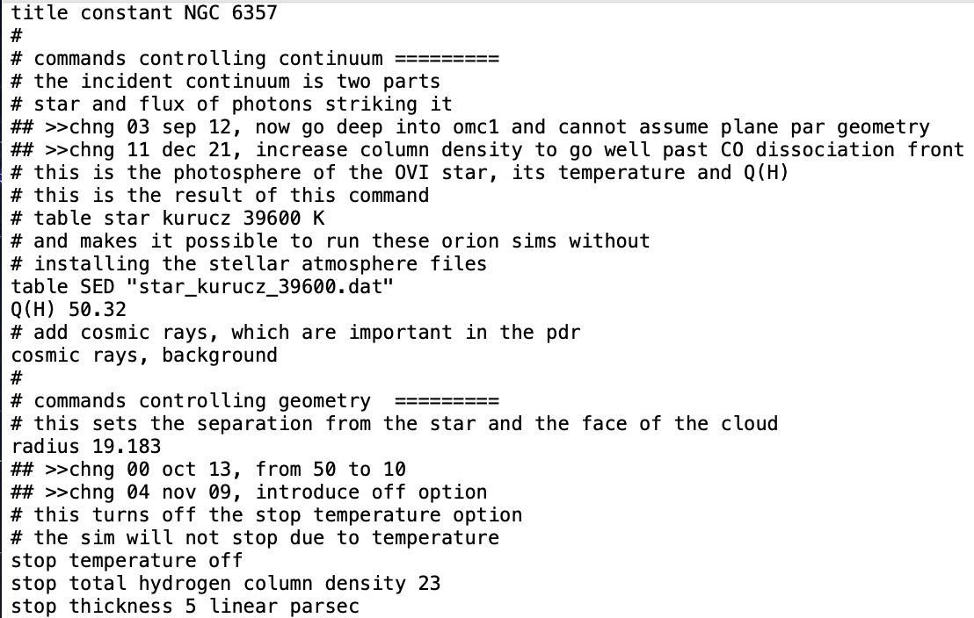
Objective
5
Use complex programs to create models of PDRS
Choose a candidate region mapped by GUSTO
Compare the model to the GUSTO spectra to deduce properties of the cloud
Source: https://www.hansonastronomy.com/ngc-6357

Slide 6
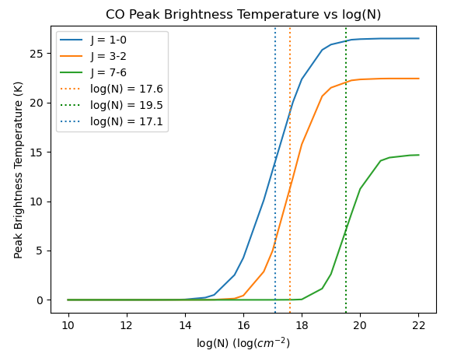
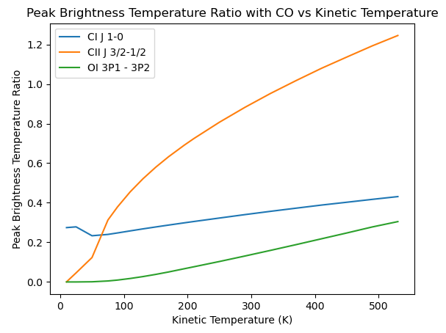
Basic Modeling: RADEX
6
Individual Lines
Line Ratios
Critical column densities for CO lines
CII/CO ratio is a good thermometer and density marker

Slide 7
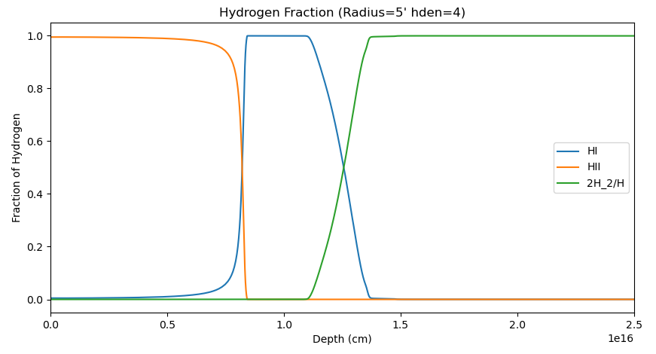
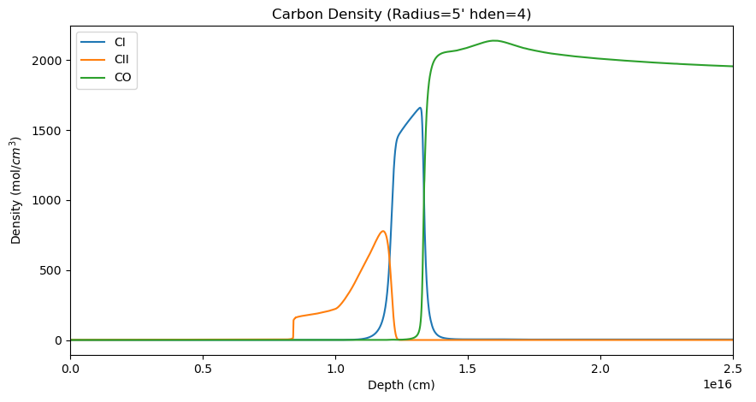
Complex Modeling: CLOUDY
7
Modeling program that takes many more input parameters and calculates many properties of the cloud
H+
H
H₂
C+
C
CO

Slide 8
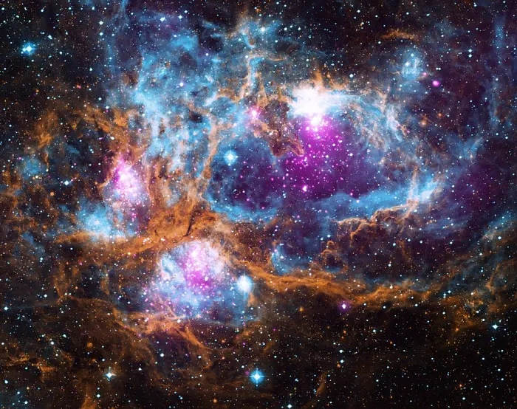
Region Candidate: NGC 6357
8
Massive star forming region observed by GUSTO
Used approximated properties of radius, photon flux, and hydrogen density to model with CLOUDY
Radiation sources (stars) and mostly spherical geometry make it good first candidate
Source: https://chandra.harvard.edu/photo/2016/ngc6357/

Slide 9
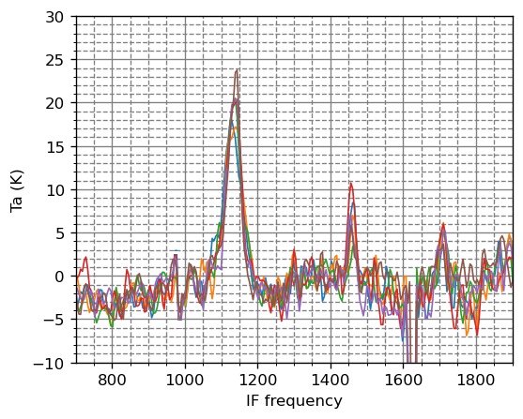
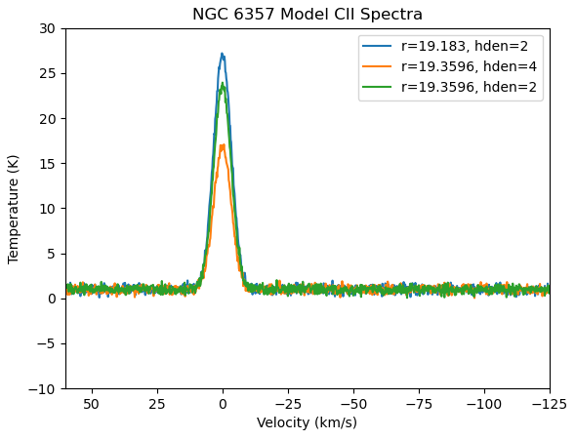
GUSTO Simulation/Comparison
9
GUSTO Observation
CLOUDY Models
NGC 6357
Carbon from the galaxy’s spiral arms
Green Model matches best

Slide 10
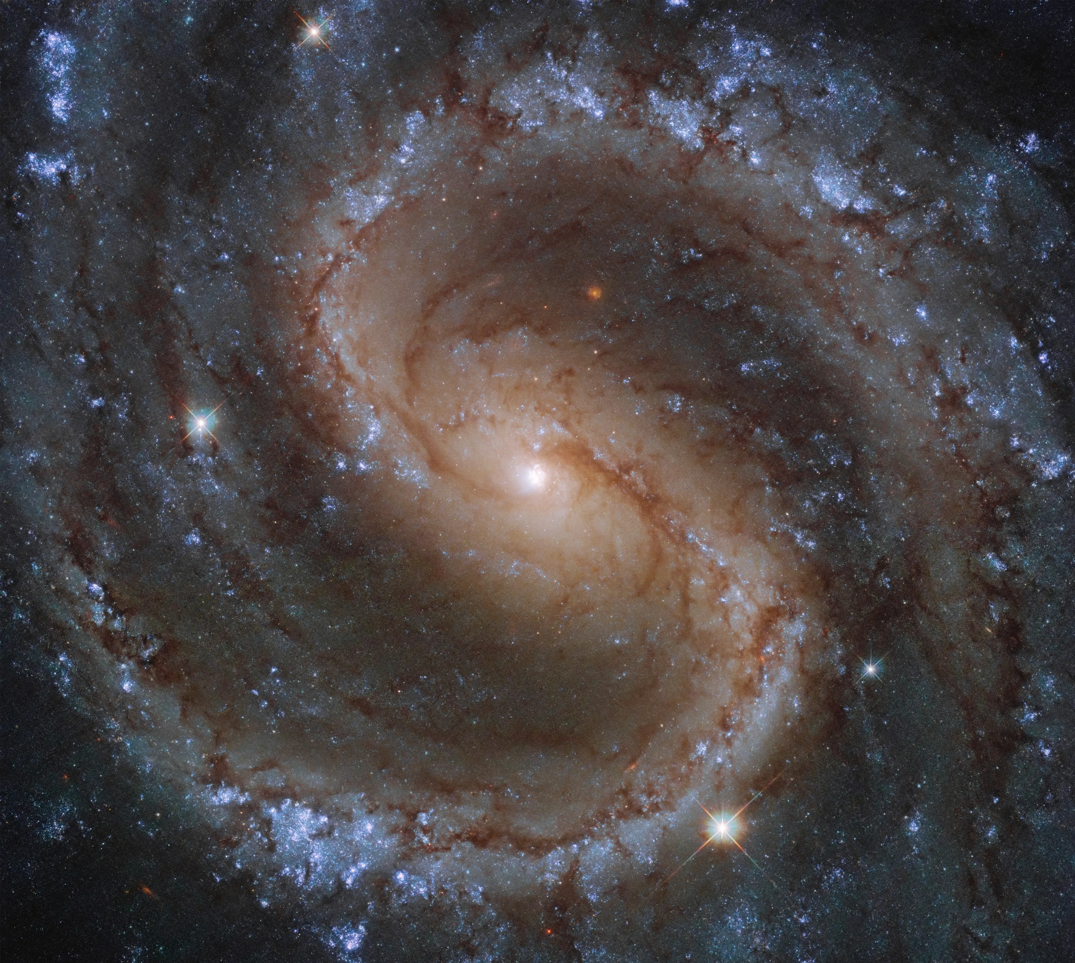

Conclusions
10
Models can be used to predict and analyze future data sets
NGC 6357 has possible properties:
Inner Radius: 2.275 $×$ 10¹⁹ cm
Initial Hydrogen Density: 100 mol/cm³
This model can be further constrained by looking at data for other molecules, like CO
This method can be used to study even more complex systems mapped by GUSTO
Source: https://science.nasa.gov/image-detail/colours-of-the-lost-galaxy-2/

Slide 11
Acknowledgements:
Dr. Christopher Walker
Dr. Craig Kulesa
GUSTO Data Processing and Science Teams
NASA

Slide 12
Thank You!

